Slide 1
Quantitative Methods to Assess Sustainability
Sustainability global commitments and obligations
David Lusseau

Slide 2
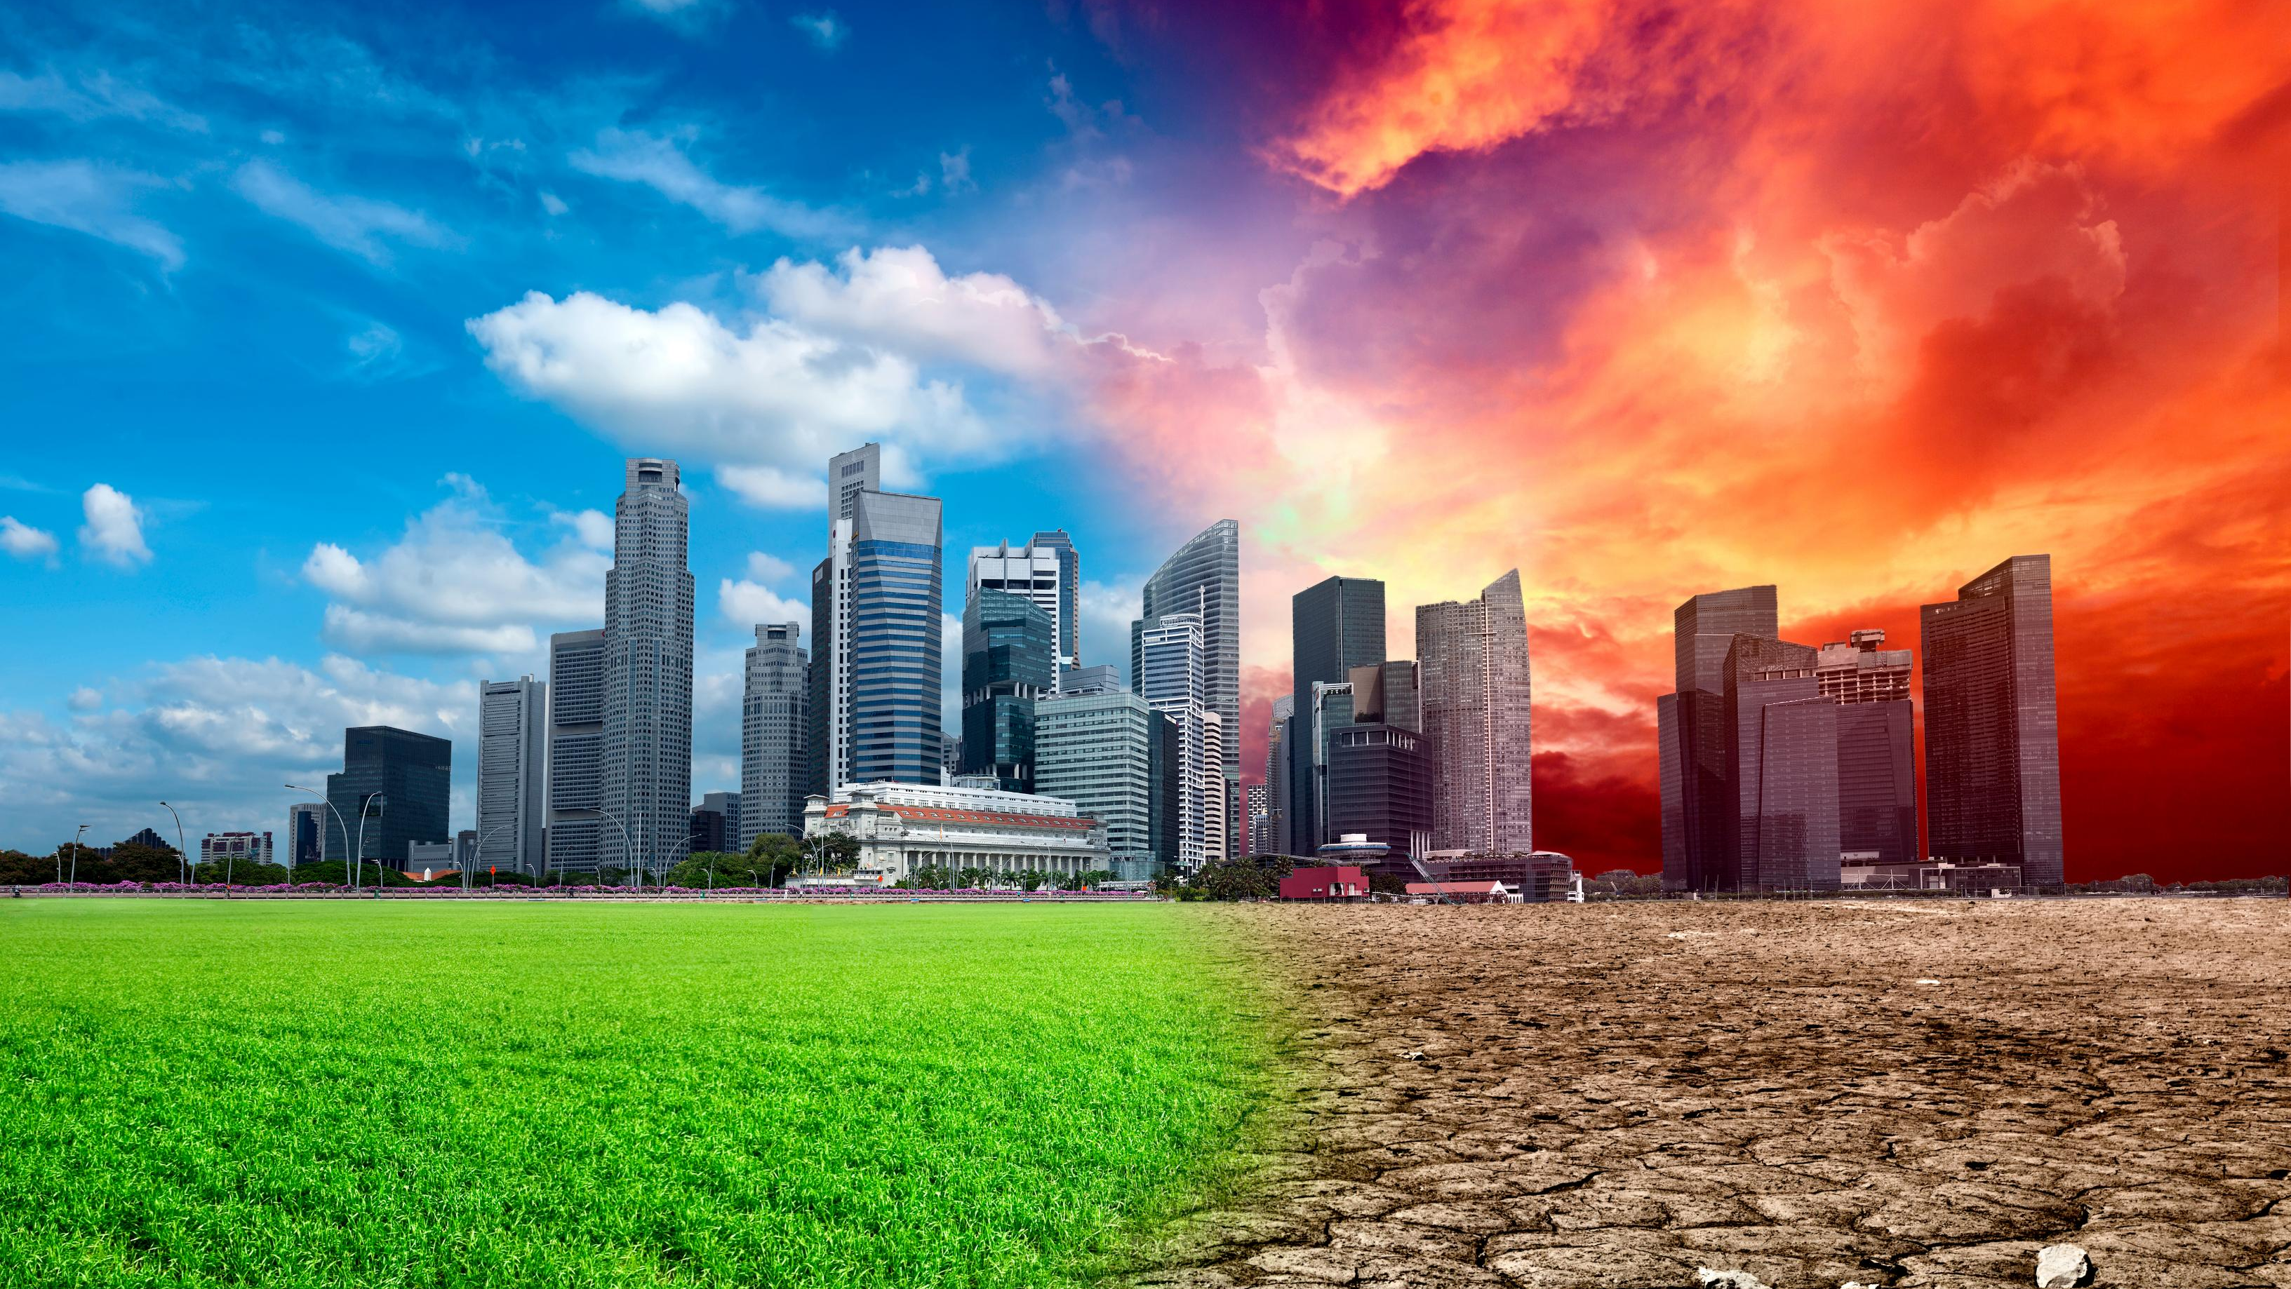

Slide 3
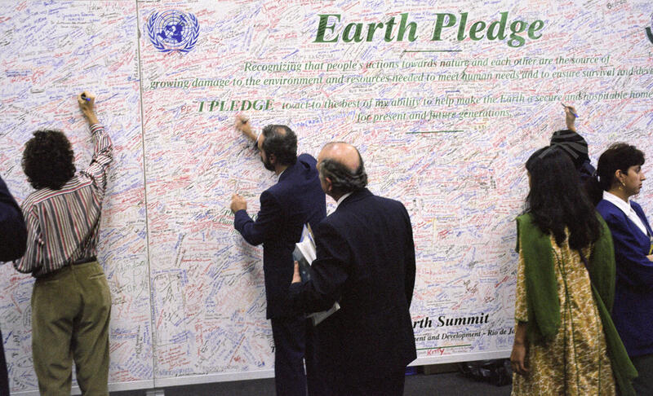
Reaching consensus
UN Photo 1992

Slide 4
Rio Declaration 1992
“Human beings are at the centre of concerns for sustainable development…”
“…equitably meet developmental and environmental needs of present and future generations.”
“… environmental protection shall constitute an integral part of the development process....”

Slide 5
What is at the origin of nowadays SDGs?
The modern sustainability concept emerged from interactions between economic development & environmentalism
Consensus I: 1972 Stockholm Declaration
Our activities (particularly industrialization) are having an impact on the global environment
We need to assess the impact of our activities and manage them

Slide 6
Universal Declaration of Human Rights (1948)
Article 1 – All human beings are born free and equal in dignity and rights.
Article 2 – Everyone is entitled to all the rights and freedoms set forth in this Declaration, without distinction of any kind.
Article 25 - Everyone has the right to a standard of living adequate for the health and well-being of himself and of his family.

Slide 7
What is at the origin of nowadays SDGs?
The modern sustainability concept emerged from interactions between economic development & environmentalism
Consensus II: 1992 Rio Declaration
Reconcile Stockholm declaration with economic development & UDHR
needed for global security
needed to adhere to Universal Human Rights

Slide 8
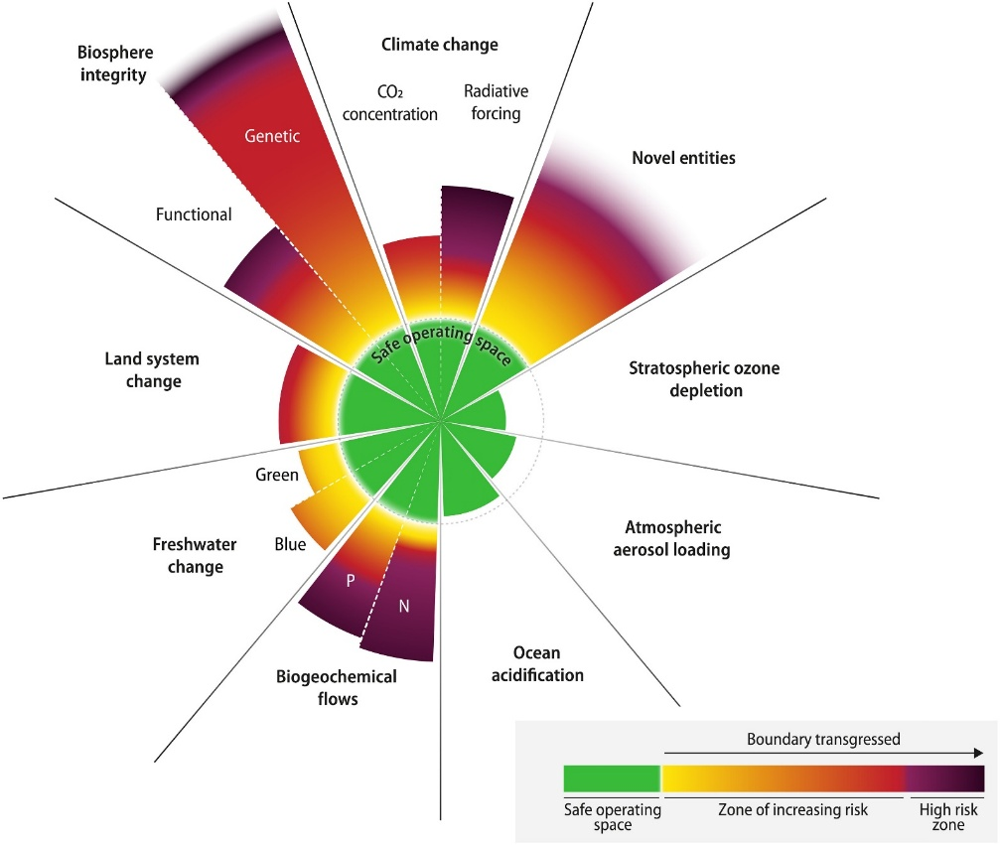

Society
Society
Economy
Economy
Environment
Environment
equitable
bearable
sustainable
viable

Slide 9
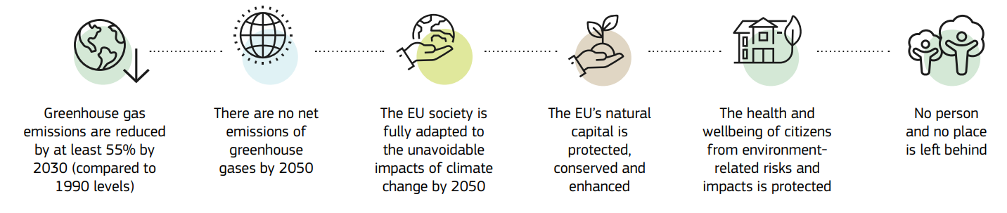
The European Green Deal
Economic growth is decoupled for GHG emissions

Slide 10
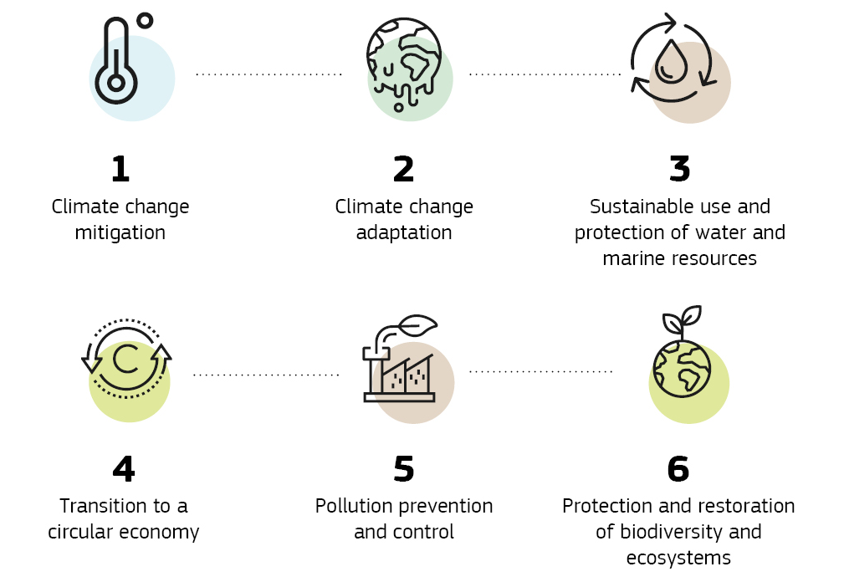
Incentivise transitions to ‘sustainable’ activities & investments
The EU Taxonomy: define environmentally sustainable economic activities
objectives

Slide 11
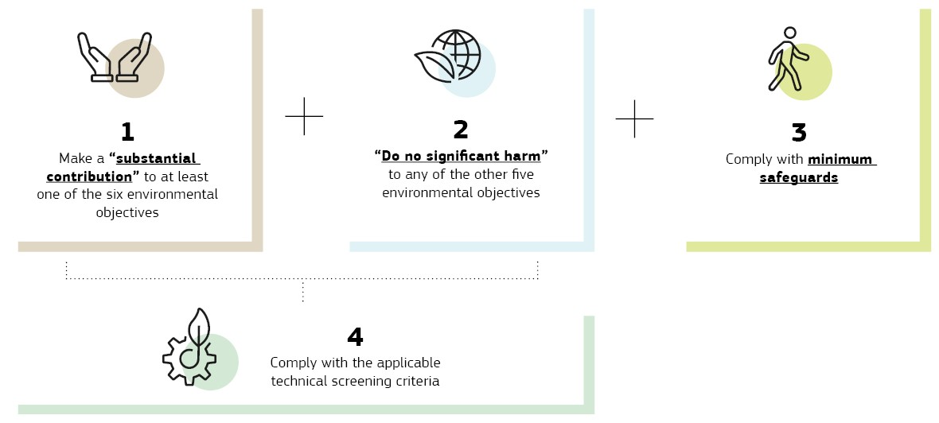
The EU Taxonomy: conditions

Slide 12




From commitments to regulations
Society
Society
Economy
Economy
Environment
Environment
equitable
bearable
sustainable
viable
Value creation
Permissible activities

